Slide 1
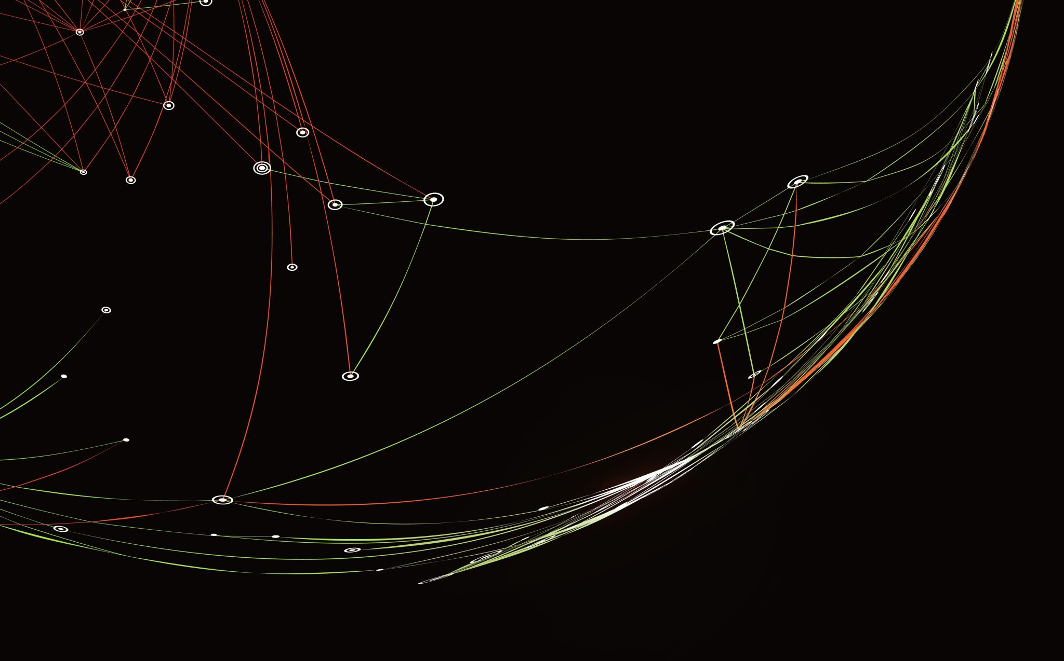
Using Machine Learning to Predict Poverty In School Districts.
Sarah Mueller, Alberto Veloso, Grant Ball

Slide 2
Introduction
In this project, our team focused on the ever-present problem of poverty in American school districts, particularly that of the state level in the year 2017-2018. The main goal of this project was to analyze which prediction algorithm is better used in different data sources. We will be using this to help determine which schools and given different data and statistics about schools are more susceptible to poverty and difficulties and find the most significant classifiers in determining the probability of a given school facing an underlying poverty issue. To do so we examined the federally available data obtainable via the Common Core of Data (CCD) and performed various regression techniques such as KNN Model, Ridge regression L2-norm, and Lasso regression and found that KNN was the most effective.

Slide 3
Our group had a tough time initially understanding an appropriate way of intertwining the results/hard data of our various benchmarks alongside the quantitative analysis or cross-references. We looked through various papers on the given website and found excellent examples such as “Multitask Prompted Training Enables Zero-Shot Task Generalization” by Victor Sanh various instances that we could use as a template and better demonstrate our future analysis and conclusions. For instance, on page 8, our group thought that we could generate various graphs similar to that of our past Homeworks and make various observations. Alternatively, papers such as ‘TensorFlow: A system for large-scale machine learning’ by Martín Abadi gave our team the basic idea of not only discussing the qualitative results, but the journey along the way and how we manipulated the various python libraries.

Slide 4
Goal
Our main goal with this project is that if given a set of data detailing various niche features about [many] American school(s) we can perform various regression algorithms and analysis to better understand the data and make predictions. The primary focus of these predictions is to evaluate the likelihood of poverty given several stats, remarkably similar to the example given on a recent quiz. The source of our data is the CCD, or as the professor so eloquently put it, “[the] CCD is a comprehensive, annual, national database of all public elementary and secondary schools and school districts”- or in other words, we will be getting our data from publicly available government records.

Slide 5
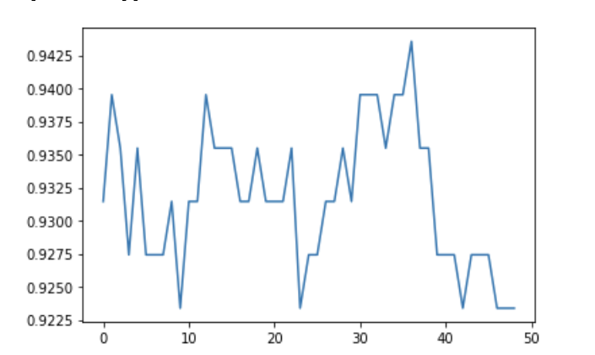
This graph demonstrates the best K, it is used in KNN regression to determine the # of nearest neighbors which is the only customizable parameter. It is critical to get an accurate K which is done by obtaining a matrix as demonstrated in the .ipnyb. This number represents the most optimal K for a best-fit model.

Slide 6
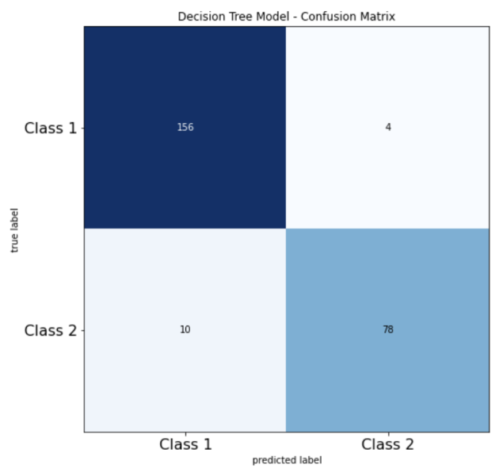
This confusion matrix shares the same principles of logistical confusion-matrix detailed below, but in this one we can see a more accurate range of values and given that the heatmap is inversed across the board diagonally represents a stronger or better fit. This can be logically explained due to the known fact that our previous logistical model tended to overfit and unperformed, inferring that the KNN model is a better fit for our group’s individual scenario but requires additional analyzation to be certain.

Slide 7
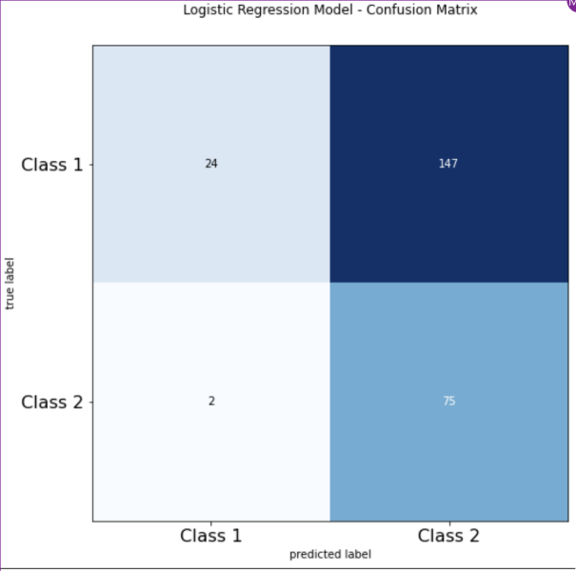
This confusion matrix demonstrates the effectiveness of our train versus our test data; which can visually represent our model’s tendency to overfit and underperform (due to lack of normalization).

Slide 8
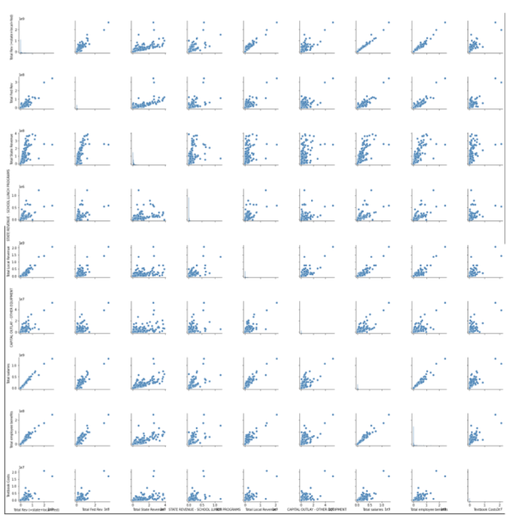
This pair plot demonstrates the (overfitted) correlation of the various variables in relation to the total state revenue. From this we can say for instance teacher’s salaries are positively related to the revenue; or with more revenue there tends to be higher salaries.

Slide 9
Final Approach
Our team's final decision was to utilize KNN Classification. We decided to use this method because it is easy to work with and simple compared to the other classification models that work with a higher number of parameters. KNN is also known as "Lazy Learner" because it does not learn anything during the training period. In other words, there is no training period for it. It stores the training dataset and only learns from it at that time of making real-time predictions. This makes KNN faster compared to the other algorithms that require training.
Another advantage of the KNN algorithm is that it is easy to implement since there are only two parameters required for its implementation and we can add new data to it safely because it will not impact the accuracy of the algorithm.

Slide 10
Conclusion
The summary of our team's conclusion is that KNN classification was able to outperform Logisitic based approaches for this particular dataset. This was primarily because of the fact that KNN is capable of outperforming logistic in cases where the there is no assumption about the shape of our data (for instance the distribution or decision boundary) as well as being able to dominate when the decision boundary is non-linear. This wasn't without its downsides though, as KNN has less customizable parameters or many features such as a table of coefficients, and generally underperforms on high-dimensional data. To prevent this however our group was able to selectively prune the data (not via KNN as it lacks principal component analysis) and ensure a high accuracy.

